Slide 1
Physics-infused Learning for Aerial Manipulator
in Winds and Near-Wall Environments
Yiming Zhang and Junyi Geng
The Pennsylvania State University

Slide 2
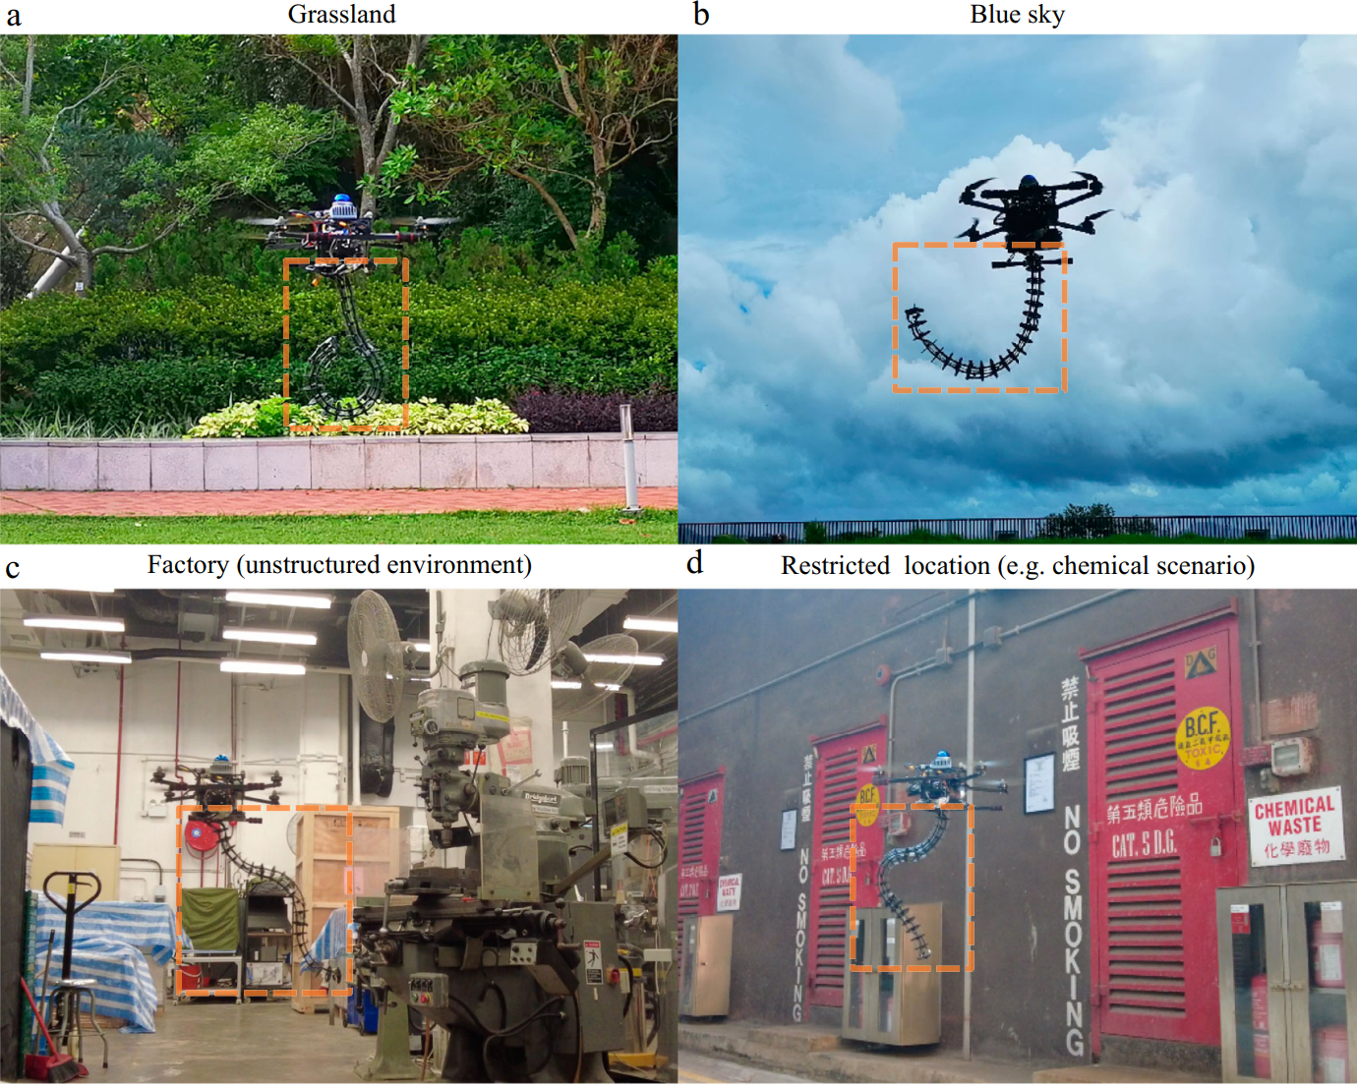
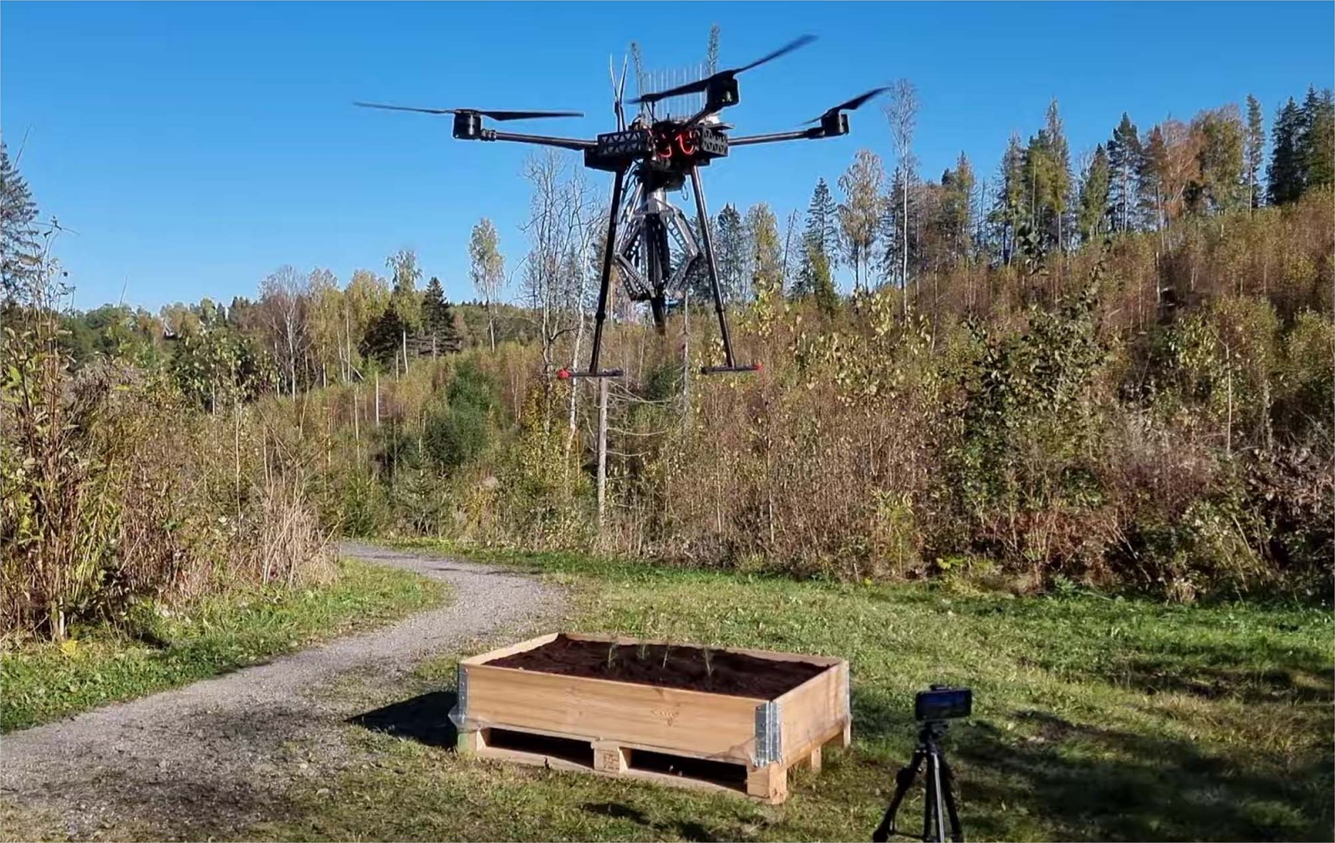
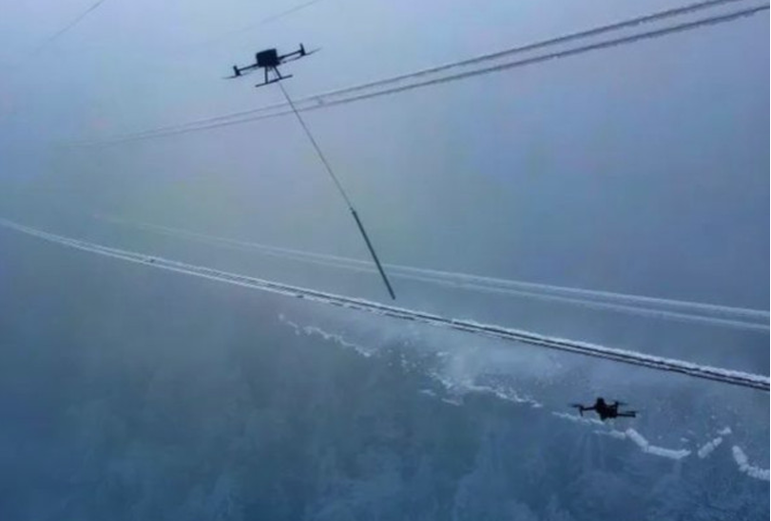
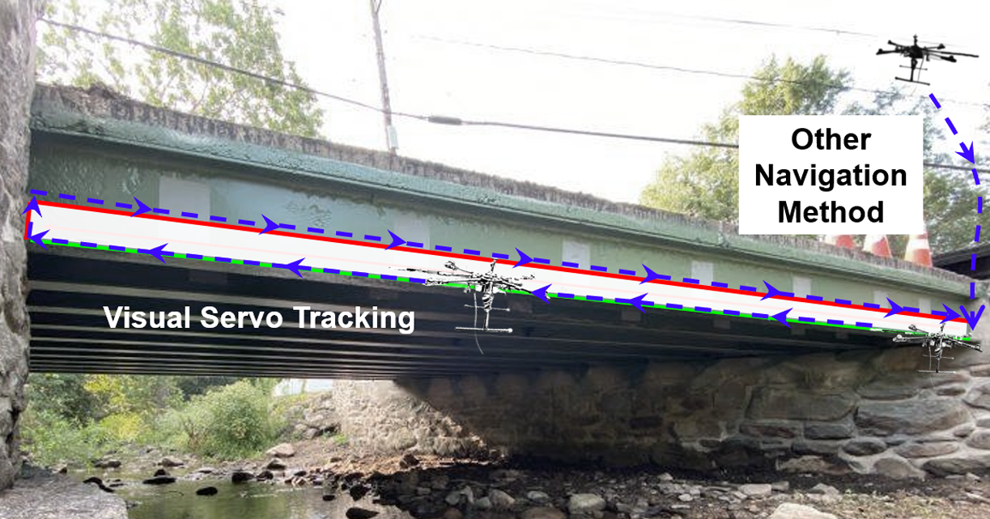
Aerial Manipulation
Aerial manipulation provides a new solution to manipulation tasks at high altitudes and in otherwise inaccessible or hazardous environments.
He et al., IROS 2023
Peng et al.,
Nature Communications, 2025
Lloyd et al.,
IEEE/ASME Transactions on Mechatronics, 2025
Li et al., Drones, 2024
Notes:
Aerial manipulation is the use of aerial robots to physically interact with the environment.
As illustrated by these representative works, aerial manipulation has been applied to a wide range of scenarios, including
Bridge painting
Factory inspection
Seed Planting
power line de-icing.
Aerial manipulation provides a new solution to manipulation tasks at high altitudes and in otherwise inaccessible or hazardous environments.

Slide 3
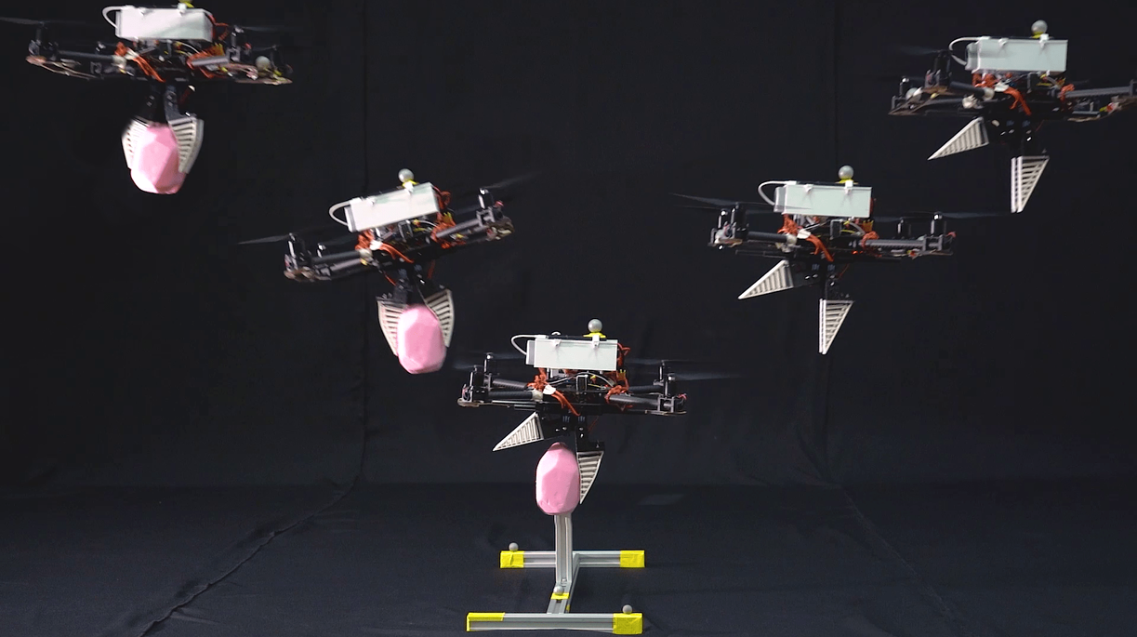
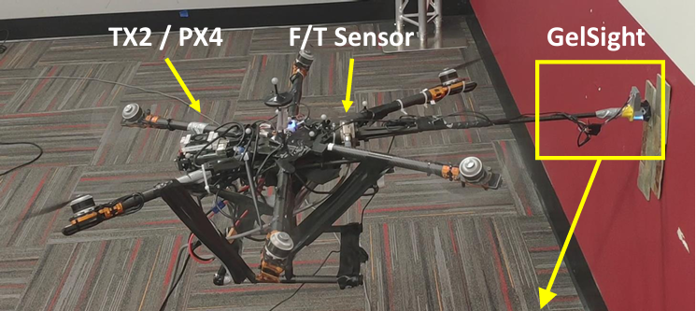
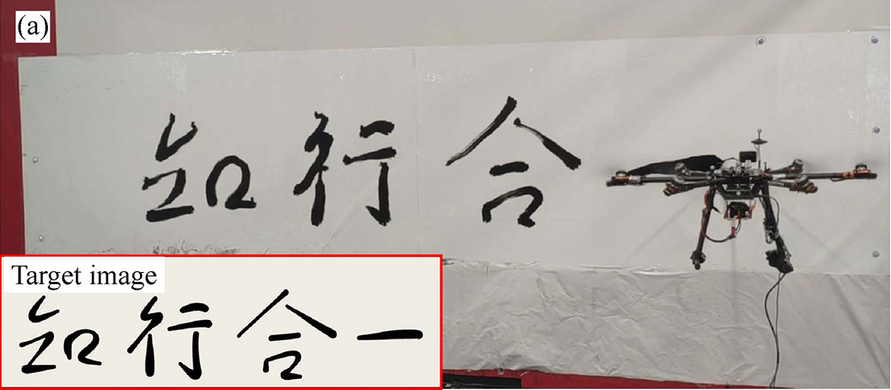
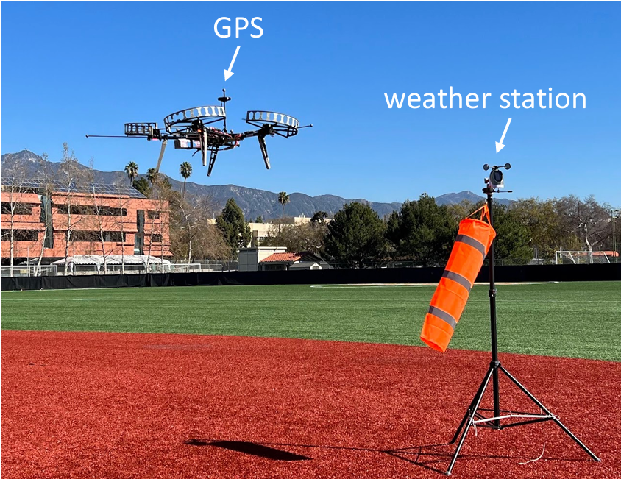
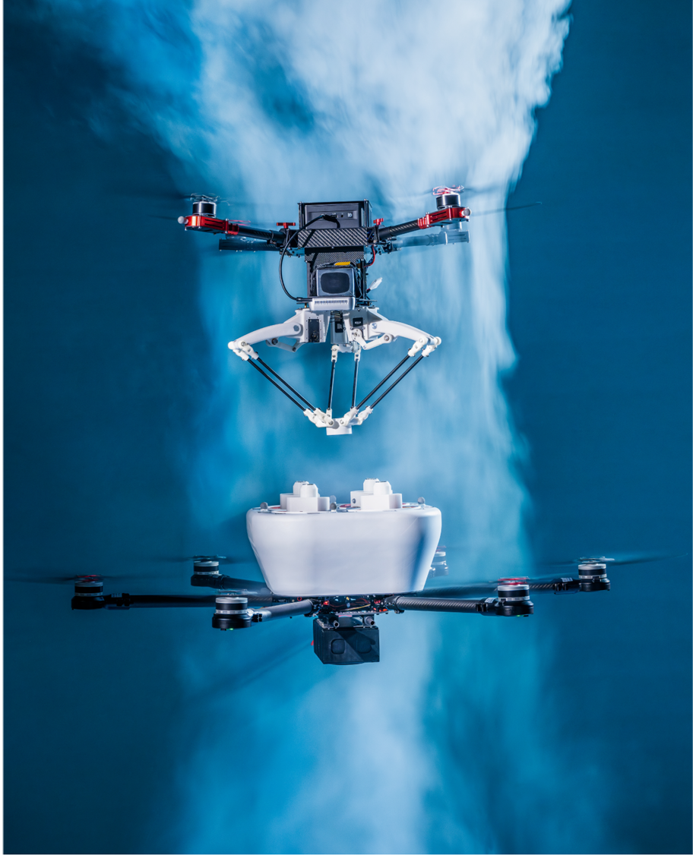
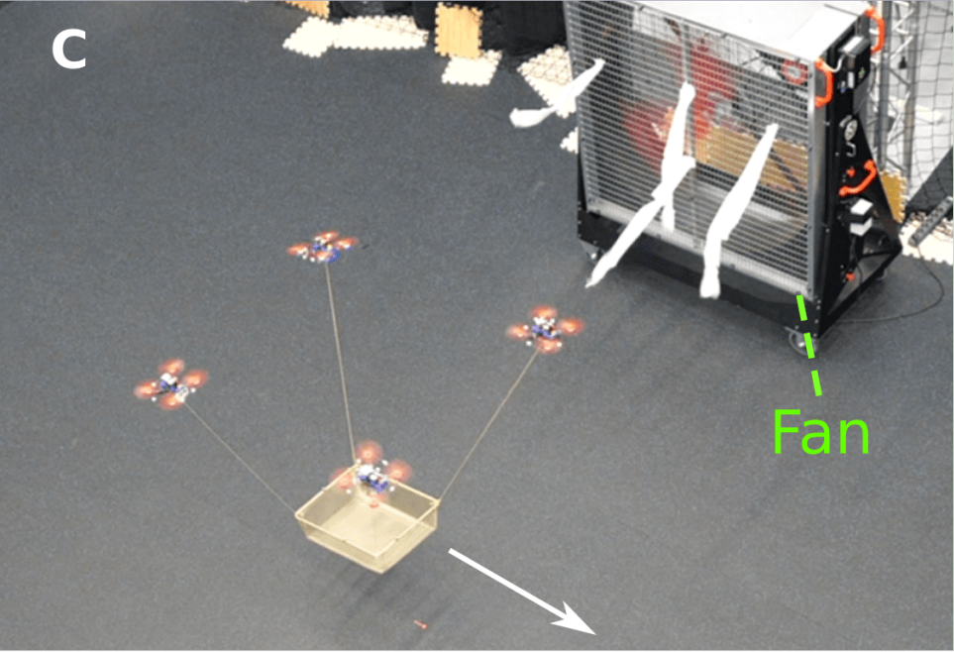
Existing Applications
Most existing approaches are developed and validated in controlled indoor environments.
Pick-and-place
Appius et al., IROS, 2022
Contact Inspection
Guo et al., ICRA, 2024
Aerial Writing
Guo et al., RA-L, 2024
Exceptions rely on controller robustness or generic disturbance rejection, rather than explicitly modeling ambient wind or considering proximity-induced effects.
O’Connell et al. Science Robotics, 2022
Cao et al., Nature, 2025
Sun et al. Science Robotics, 2025
Notes:
Research in aerial manipulation has seen increasing interest. Most existing aerial manipulation approaches are developed and validated in controlled indoor environments.
As shown in the top row, representative tasks such as pick-and-place, contact inspection, and aerial writing are typically demonstrated under lab conditions, but they also simplify the underlying aerodynamics.
Related work (DAIML does not have manipulator)
second sentence convert to 2 bullet points
On the other hand, there are a few notable exceptions that move beyond purely indoor environments, shown in the bottom row. These works demonstrate impressive outdoor or wind-affected experiments. However, these examples still either rely on controller robustness or generic disturbance rejection, rather than by explicitly modeling ambient wind or proximity-induced aerodynamic effects.
As a result, while these approaches can tolerate disturbances to some extent, they do not directly capture how wind and nearby structures in a precise way, which is important in outdoor environments.

Slide 4
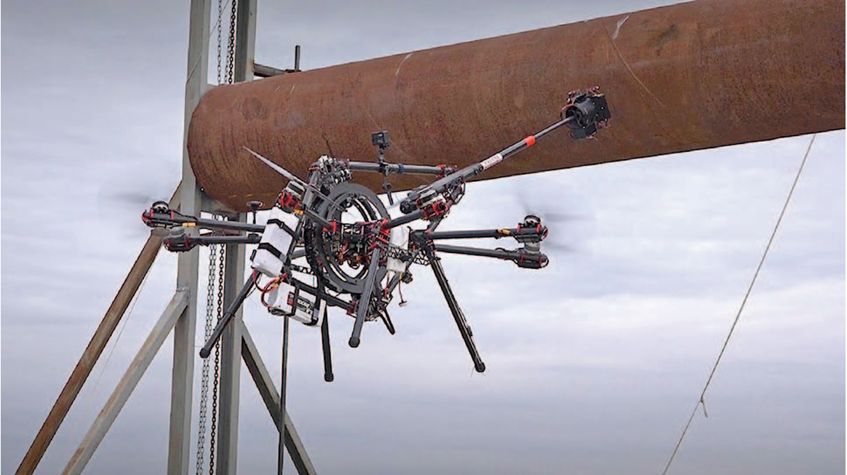
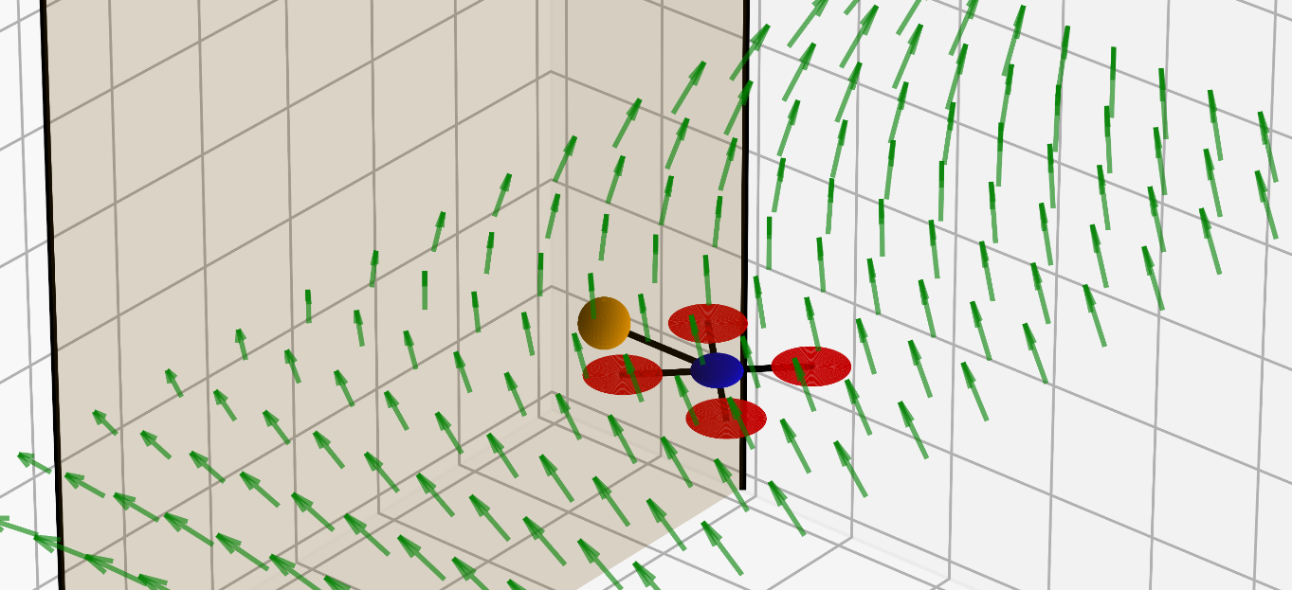
Challenges and Our Contribution
Aerial manipulation is affected by complex aerodynamic disturbances:
Strong ambient wind
Proximity-induced effects near structures
Ollero et al.,
IEEE Robotics & Automation Magazine 2018
Limitations of existing approaches:
CFD-based modeling: computationally expensive
Simplified models: inaccurate in strong wind and unable to capture near-wall aerodynamic effects
We propose to use an online computation friendly method to handle disturbance from near-wall wind effects.
Notes:
Hide limitation and proposed method in animation
Proposal -> Contribution
Aerial manipulation is affected by complex aerodynamic disturbances.
As we mentioned in the previous slide, challenges include strong ambient wind and proximity induced effects, where disturbances are spatially distributed
proximity induced disturbances are complex, and existing modeling approaches are either too expensive for real-time deployment or too inaccurate.
CFD could be computationally expensive, and simplified aerodynamic models are often inaccurate in strong wind conditions and fail to capture near-wall aerodynamic effects.
We propose to use an online computation friendly method to handle disturbance from near-wall wind effects.

Slide 5
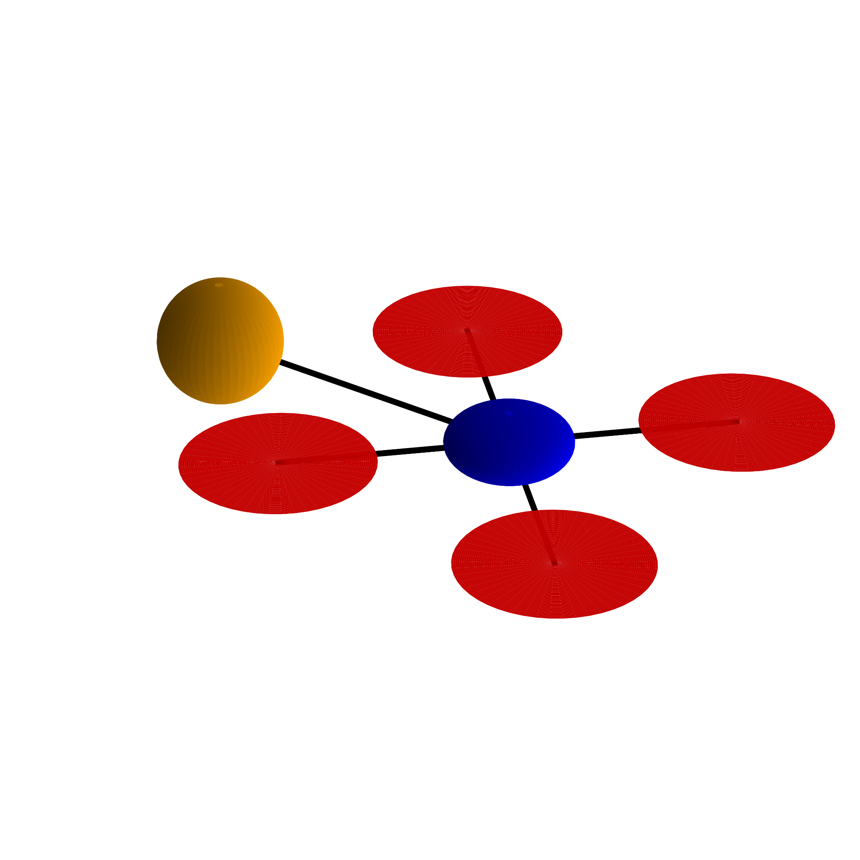
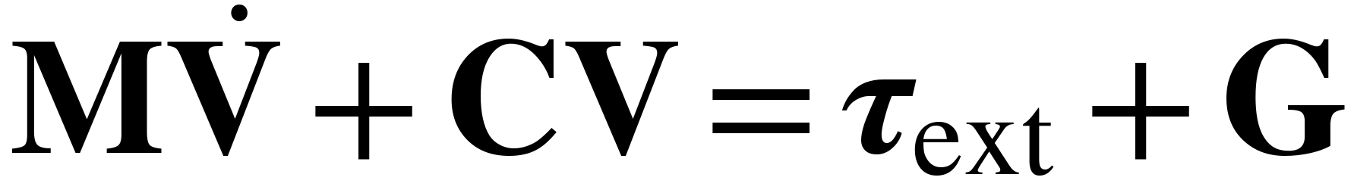
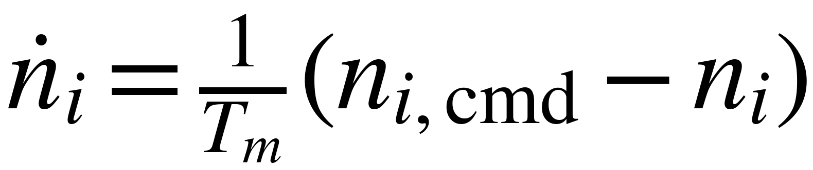
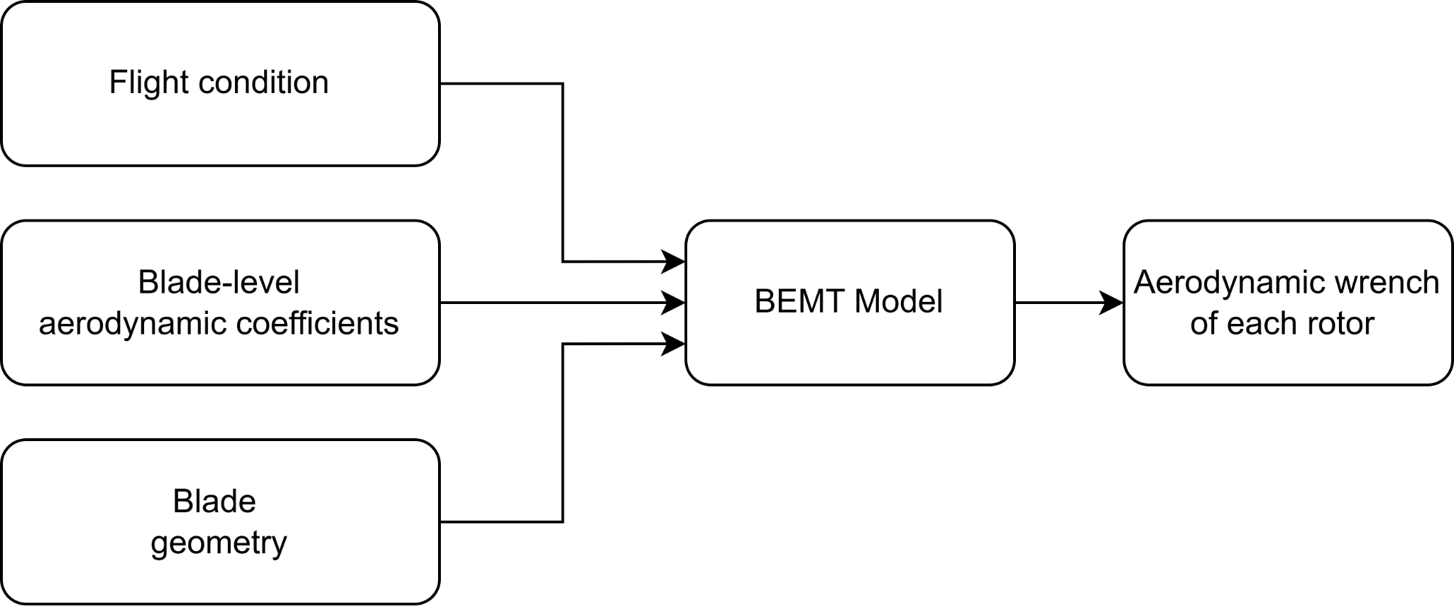
Modeling
Drone and end-effector dynamics:
End effector
Vehicle body
Motor speed dynamics:
Aerodynamics (Blade Element Momentum Theory) to accurately model strong wind and near-structure interactions:
Propeller
Motor
Notes:
emphasize BEMT benefit: consider each rotor individually to capture detailed aerodynamic effects
Now let’s take a look at the model. We model a quadrotor drone with an end-effector rigidly connected to the vehicle body. The vehicle body and end effector comply with the rigid body dynamics. We can use Euler’s equations of motion to represent this.
We also use first order delay system to model the dynamics of rotor rotational speed.
Blade Element Momentum Theory, abbreviated as BEMT, is a well established theory. It takes flight condition, blade-level aerodynamic coefficients and blade geometry.
flight condition include rotor rotational speed, rotor hub velocity, ambient wind velocity.
blade-level aerodynamic coefficients contains the parameters that determines the lift and drag models.
the blade geometry includes the chord length and pitch angle.
Then it produces the aerodynamic wrench generated by a single rotor. With this model and known ambient wind distribution around a structure , we can capture the aerodynamic disturbances at different location near the structure.

Slide 6
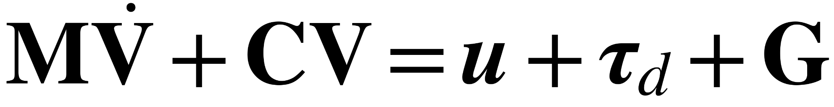
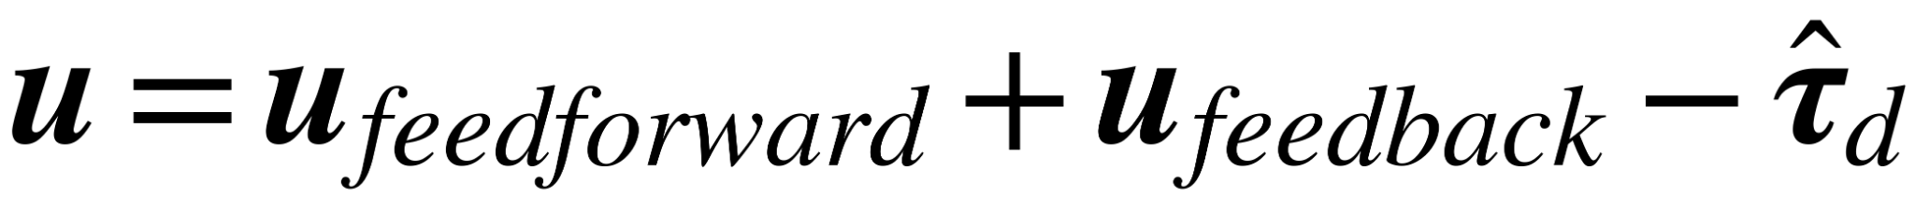
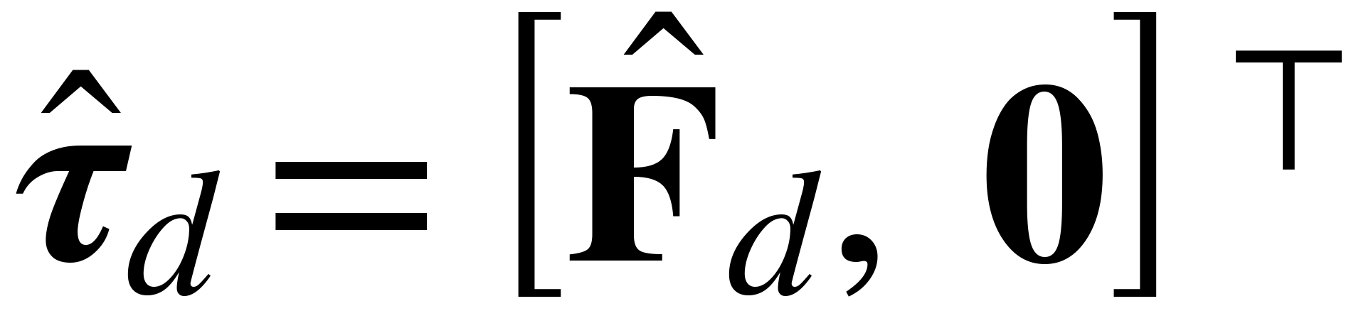
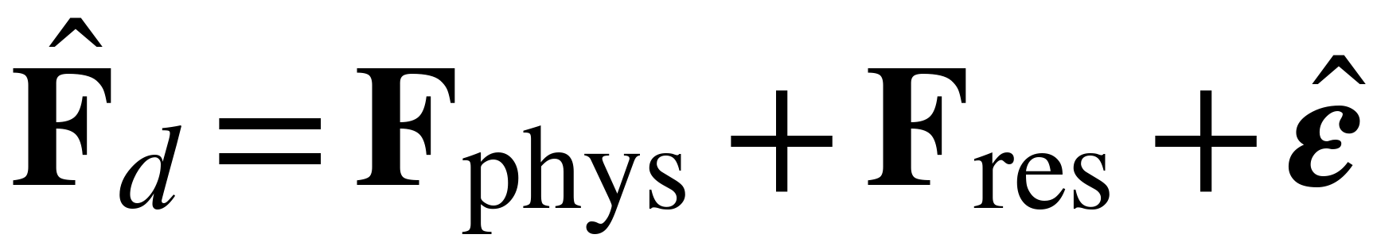

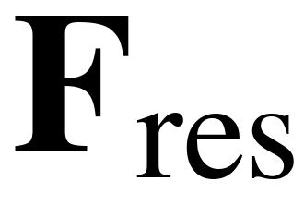
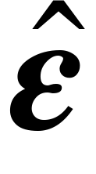
Methods – Overview
Integrating disturbance compensator into the controller:
estimated disturbance wrench
force components only
The estimated disturbance force is decomposed into three parts:
Physics-based prediction: is good generalization but has limited expressiveness
Learned residual prediction: is flexible in fitting but has limited generalization
Online adaptation: can estimate unmodeled disturbances but has latency
Notes:
tau_d_hat highlight as estimated disturbance (animation)
Our main idea is to add a disturbance compensator to the controller. In the Euler's equations of motion, the controller input can be decomposed into feedforward , feedback term, and a disturbance compensation term. And because force disturbances can be more reliably estimated than torque disturbances in practice, we focus on compensating the force component only, which is denoted by F_d_hat.
Now the F_d_hat can be decomposed in to 3 parts: a physics based disturbance prediction, a learned residual prediction and an online adaptation term. They have different pros and cons:
physics based modeling can usually generalize well but the limited expressiveness makes it not flexible enough to capture all the details of the dynamics. A learned residual in contrast, is flexible in fitting but meets challenges in generalization. The online adaptation can estimate unmodeled disturbances but will experience latency.
So our strategy is this: physics based prediction is used as the primary prediction model, learned residual model then capture the prediction error from the physics model, and finally online adaptation provides final, flight-specific correction. All these together, determines the compensated disturbance force.

Slide 7
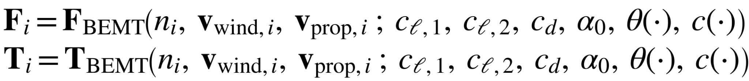
Methods – Physics-Based Learning
We will use BEMT as physics based prediction model. However, blade-level aerodynamic coefficients are usually unknown.
Flight condition
Blade-level
aerodynamic coefficients
Blade
geometry
From test data
To be
determined
Directly
measurable
We will collect some test data and solve a parameter learning problem to find the best-fit aerodynamic coefficients.
Notes:
In physics-based prediction, as our primary prediction model, we will leverage the BEMT model.
Just to recap that BEMT takes flight condition, blade-level aerodynamic coefficients and blade geometry to generate predicted aerodynamic wrench.
Here, the flight condition is available from the sensors or estimation techniques. THe blade geometry can be directly measure using measuring tools. The only unknown to be learned is the blade-level aerodynamic coefficients. And we will collect some test data and solve a parameter learning problem to find the best-fit aerodynamic coefficients.

Slide 8
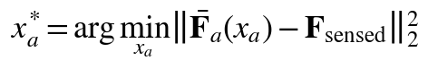
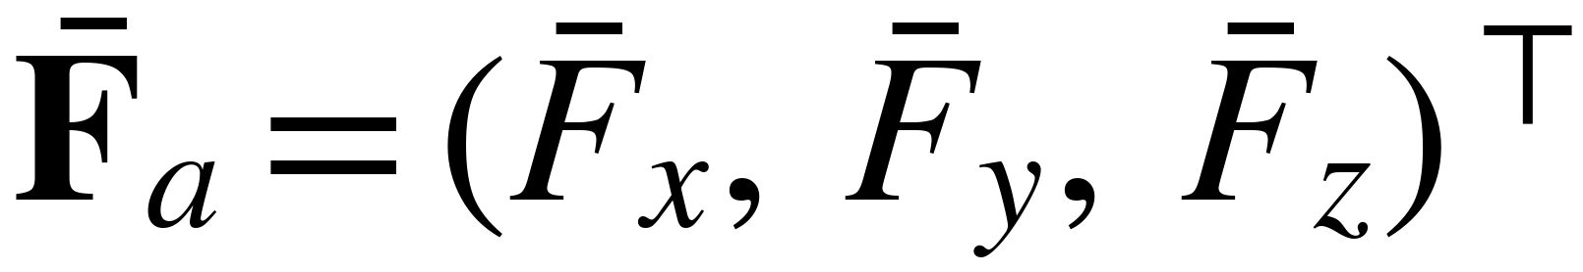
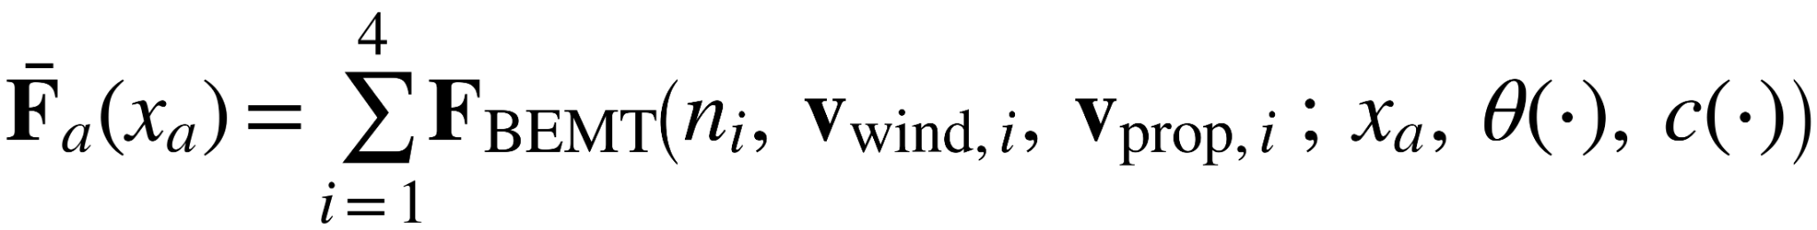
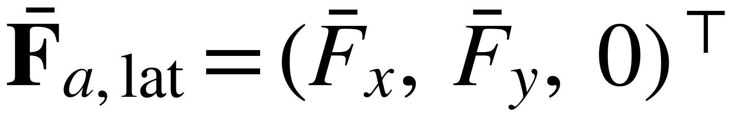
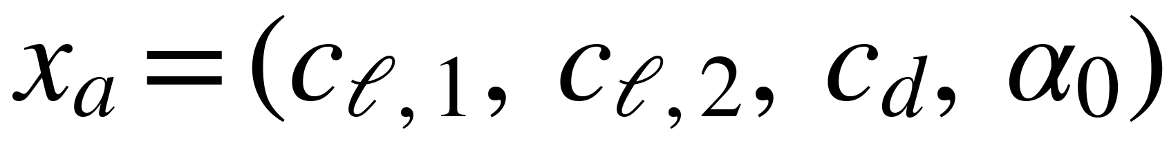
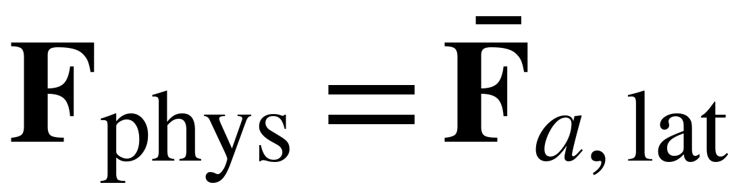
Methods – Physics-Based Learning
Learn the aerodynamic coefficients to complete the BEMT model, by minimizing the prediction error of net aerodynamic force:
Estimated net aerodynamic force:
Take lateral component as
disturbance
Thrust-dominated component
Aerodynamic coefficients to be learned:
We can use free flight data under various wind conditions (near-wall condition is only optional) to learn this model.
Notes:
To solve the parameter learning problem, we are going to fine the aerodynamic coefficients to minimize the prediction error of the net aerodynamic force.
Here F_sensed which comes from collected test data
F_a_bar is the net aerodynamic force prediction from all 4 rotors.
x_a is the vector of the aerodynamic coefficients to be learned.
Please note that We deliberately use force measurements only and do not rely on torque data, since net forces can be reliably acquired from IMU, along with other standard sensing devices while torque sensing or estimation could be less accurate.
After we find the optimal aerodynamic coefficients, we can use that to predict net aerodynamic force F_a_hat on the fly. The net aerodynamic force can be decomposed into axial component and lateral component. The axial component is dominated by thrust, the lateral component is the disturbance to compensate. Therefore, we are using the lateral component only as our physics based disturbance prediction.

Slide 9
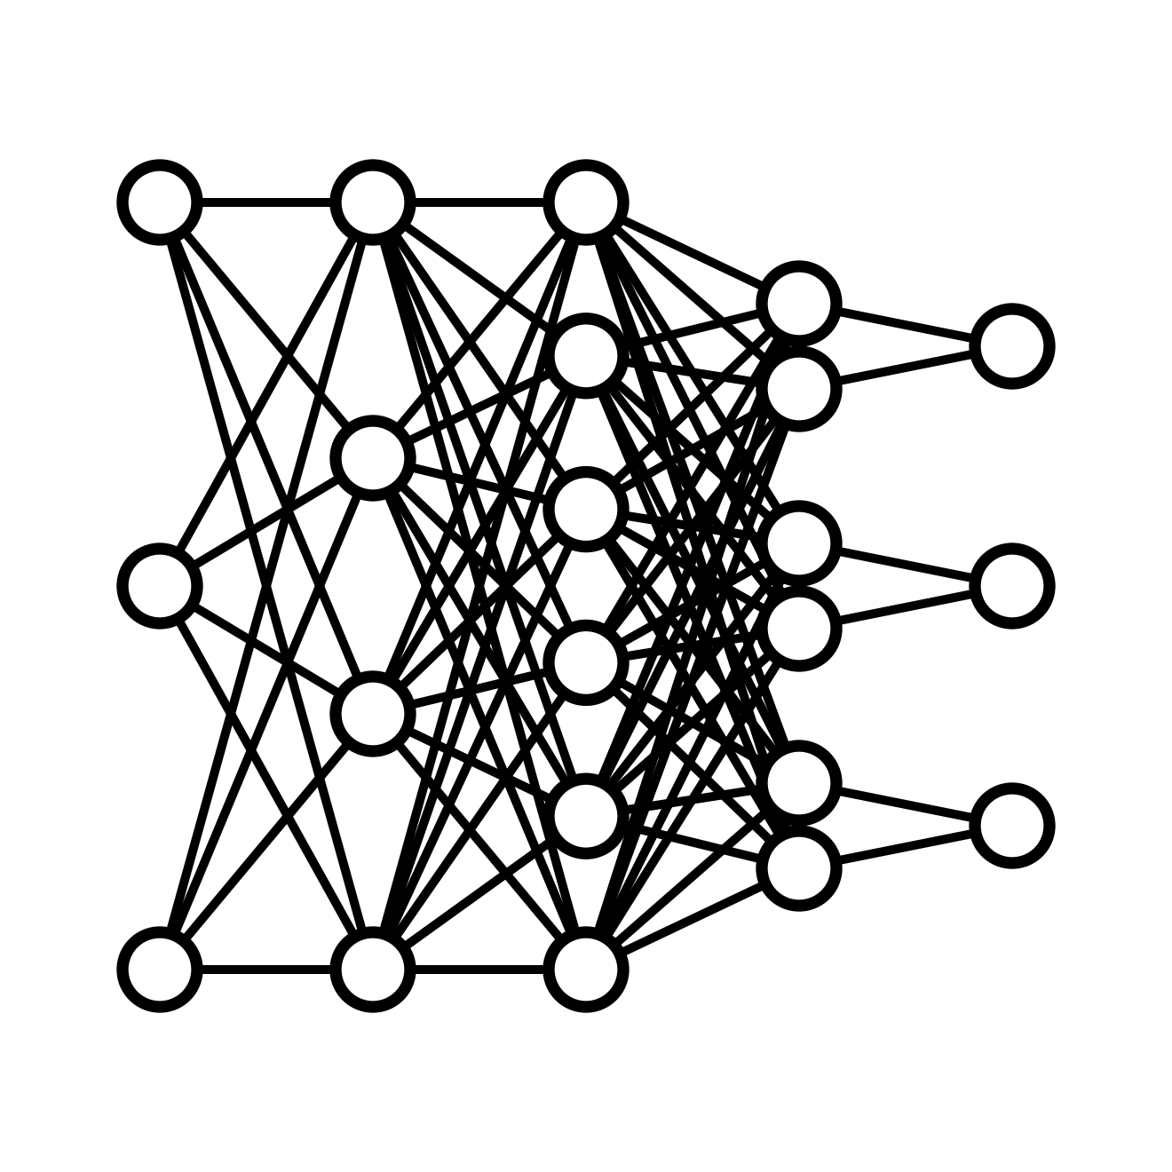
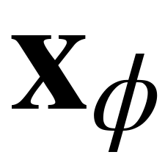
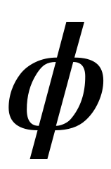
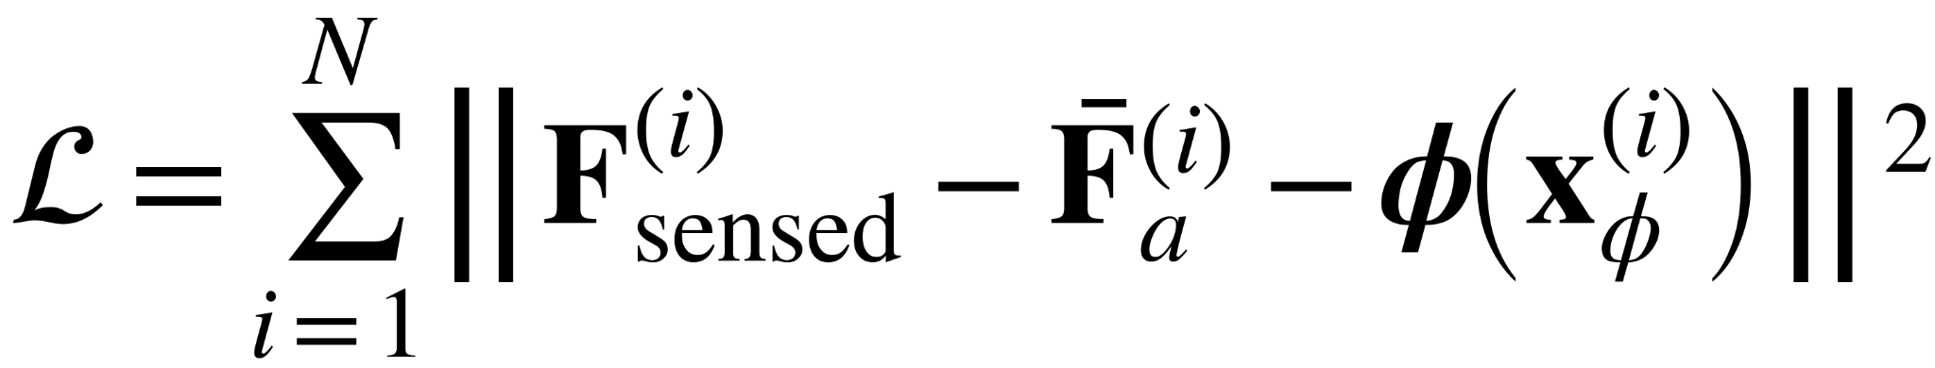
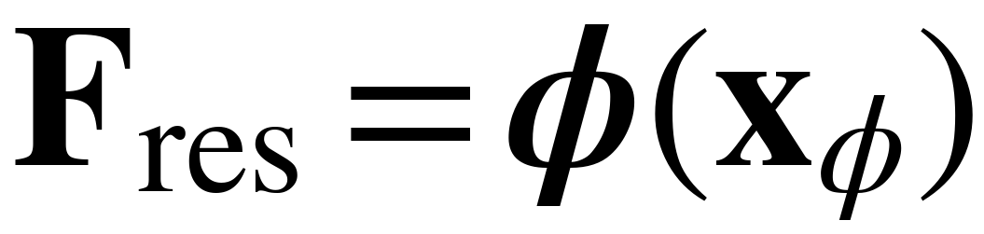
Methods – Residual Learning
Multihead network:
Free flight data
(near-wall condition is only optional)
multihead NN
vehicle twist, pose
rotor rotational speeds
background wind velocity
residual forces
Use the network to minimize the mismatch between the BEMT-predicted forces and the measured forces:
Notes:
Because the physics model is parameterized by only a small number of aerodynamic coefficients, it may not capture all the non-negligible effects from the flight data. So we will leverage a neural network to handle the residual.
We choose a multihead network and train it on free flight data. The input contains vehicle twist and pose, rotor rotational speeds, background wind velocity. The network outputs the residual aerodynamic force not captured by BEMT model. The loss is designed to minimize difference between sensed net aerodynamic force and the net prediction which include the residual force and the physics predicted force. Once the network is trained, we can use online sensor input to predict the residual disturbance.

Slide 10
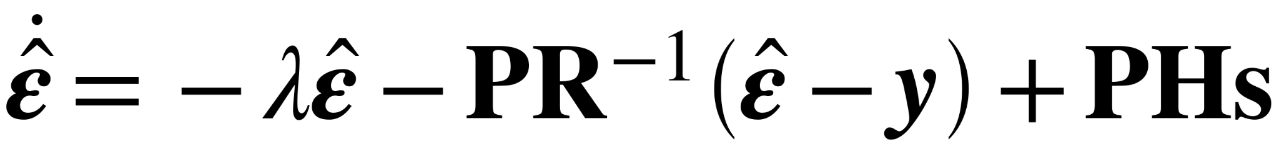
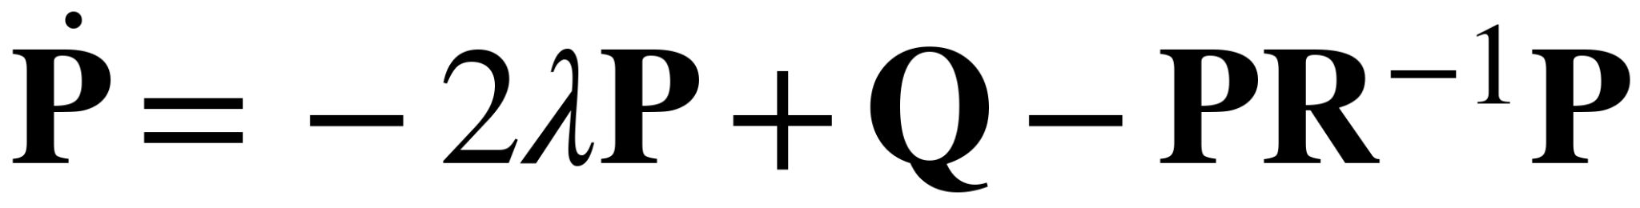
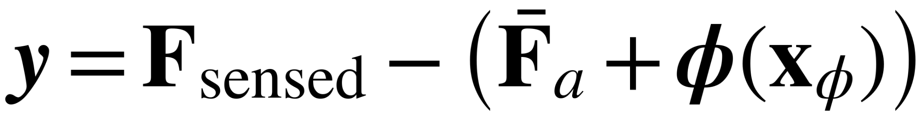
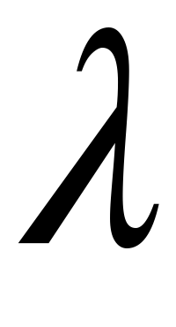



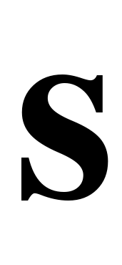

Methods – Online Adaptation
Online adaptation corrects unmodeled disturbances using force residuals, including aerodynamic and contact-induced effects:
Residual update:
Covariance update:
Innovation:
: the regularization factor
and : the gain matrices
: the covariance matrix
: the control error
: the coefficient
Notes:
Finally, the last piece of disturbance compensator is the online adaptation. The Online adaptation corrects unmodeled disturbances using force residuals.
The residual has a regularization term, an innovation correction weighted by covariance and control error adaptation term.
The adaptation process is similar to the one in a kalman filter.
Any sensed force difference from the prediction will be captured by the innovation including contact-induced effects.
As a result, the online adaptation provides a flight-specific correction which can capture unmodeled disturbances and adapt accordingly.
Here we use \hat{F}_a, not \hat{F}_a,lat because F_sensed also include the thrust component, we cancel that out

Slide 11
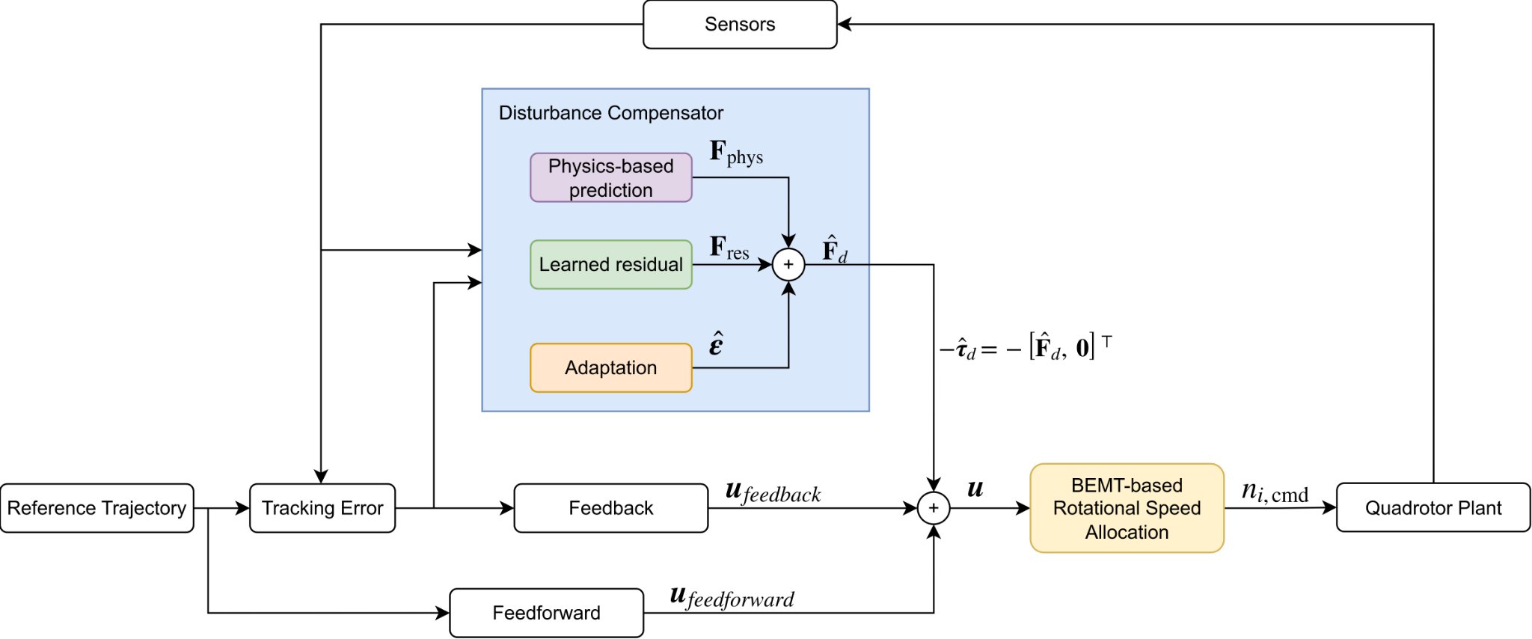
Methods – Summary
The controller is augmented with the proposed disturbance compensation.
Notes:
Animation to keep attention on part of diagram
This is a control diagram describing how we can integrate the disturbance compensator into the controller.
At high level, we have a feedback system. The reference trajectory and sensor data can produce tracking error, and together, they can calculate feedback and feedforward term. Before passing this to the downstream, a disturbance compensation term is added.
In the disturbance compensator, there are three components:
The physics-based prediction model and the learned residual model will take sensor data to give a prediction of the disturbance, the adaptation process will take the sensor data, control errors and the predictions to calculate the adaptation term. And finally the sum of the three components generates the estimated disturbance force, and the force is used to form the compensated wrench which will be added to the nominal control input.
Finally the BEMT based rotational speed allocation will convert the input wrench to rotational speed before assigning it to the plant.

Slide 12
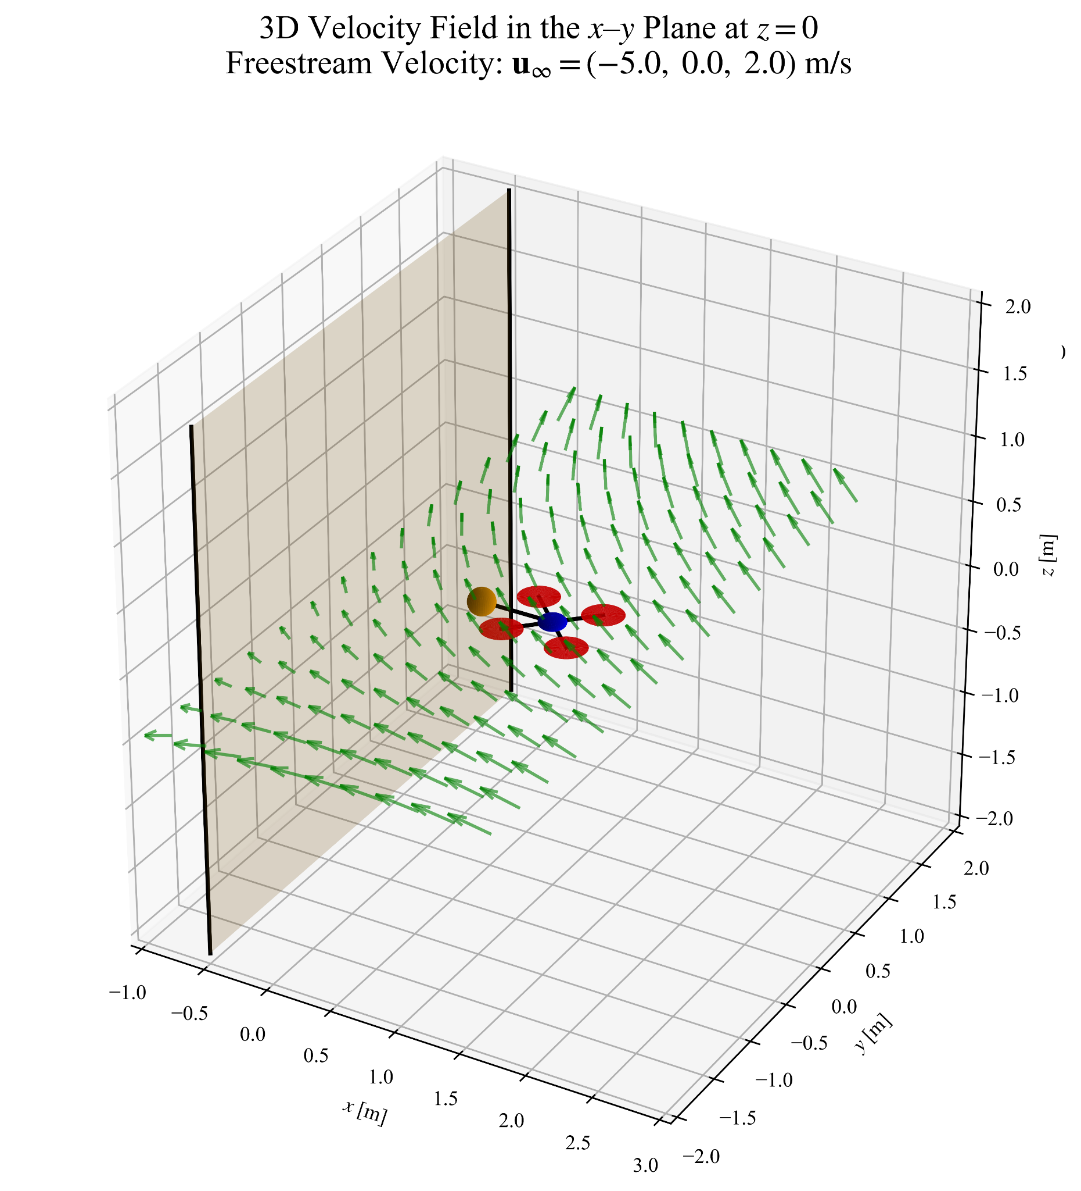
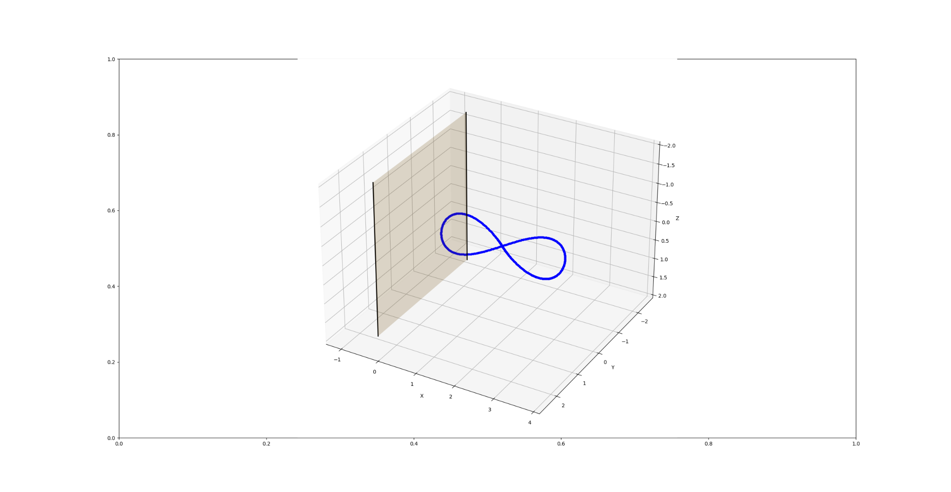
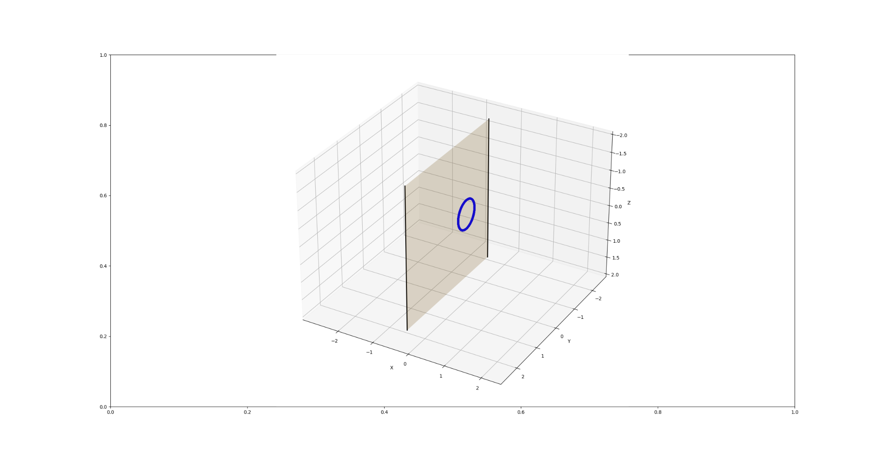
Simulation Environment Setup
Simulate an aerial manipulation near a tall building subject to strong wind:
Vertical wall
Horizontal and vertical wind
End-effector wall-contact
Sensor misalignment and noise
Finer BEMT discretization in simulation than in learned model
The quadrotor has two tasks:
Figure-eight near-wall flight
spatially distributed wind field
Circular wall-contact flight
spatially distributed wind field
unmodeled contact disturbance
Notes:
add task traj plot
mention BEMT learned has coarser integration steps and sim is finer
We verify the controller design in the simulation.
We design a scenario to
It will travel in a spatially distributed wind field

Slide 13
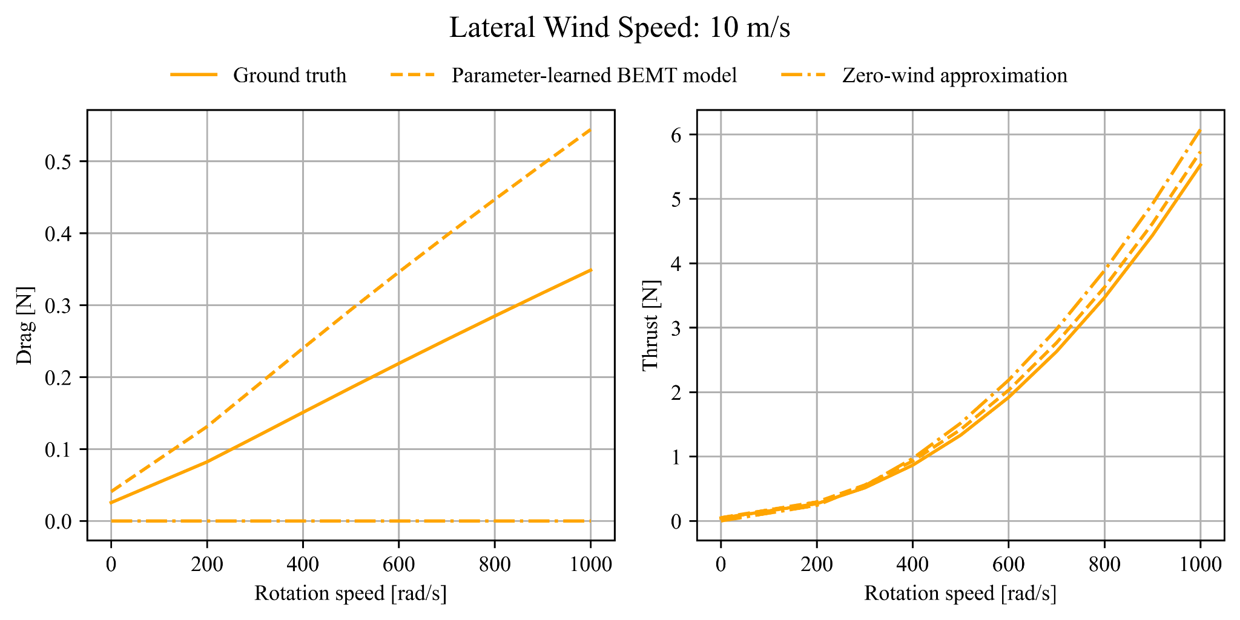
Result – Offline Physics Learning
Comparison between parameter-learned BEMT model and a baseline (zero-wind approximation):
Zero-wind approximation: a static thrust map assuming no ambient wind, as commonly adopted in existing flight controllers.
BEMT-based prediction captures drag
Parameter-learned BEMT has better drag and thrust prediction.
Notes:
Zero-wind approximation: emphasizes this is quadratic like / one type of overly simplified model
Though noise and misalignment and modeling precision may impact the accuracy of prediction, the BEMT still captures drag and has a better alignment in thrust.
Highlight the scale is different
A better thrust alignment also means when we are allocating rotational speed, we can assign thrust to each rotor accurately.

Slide 14
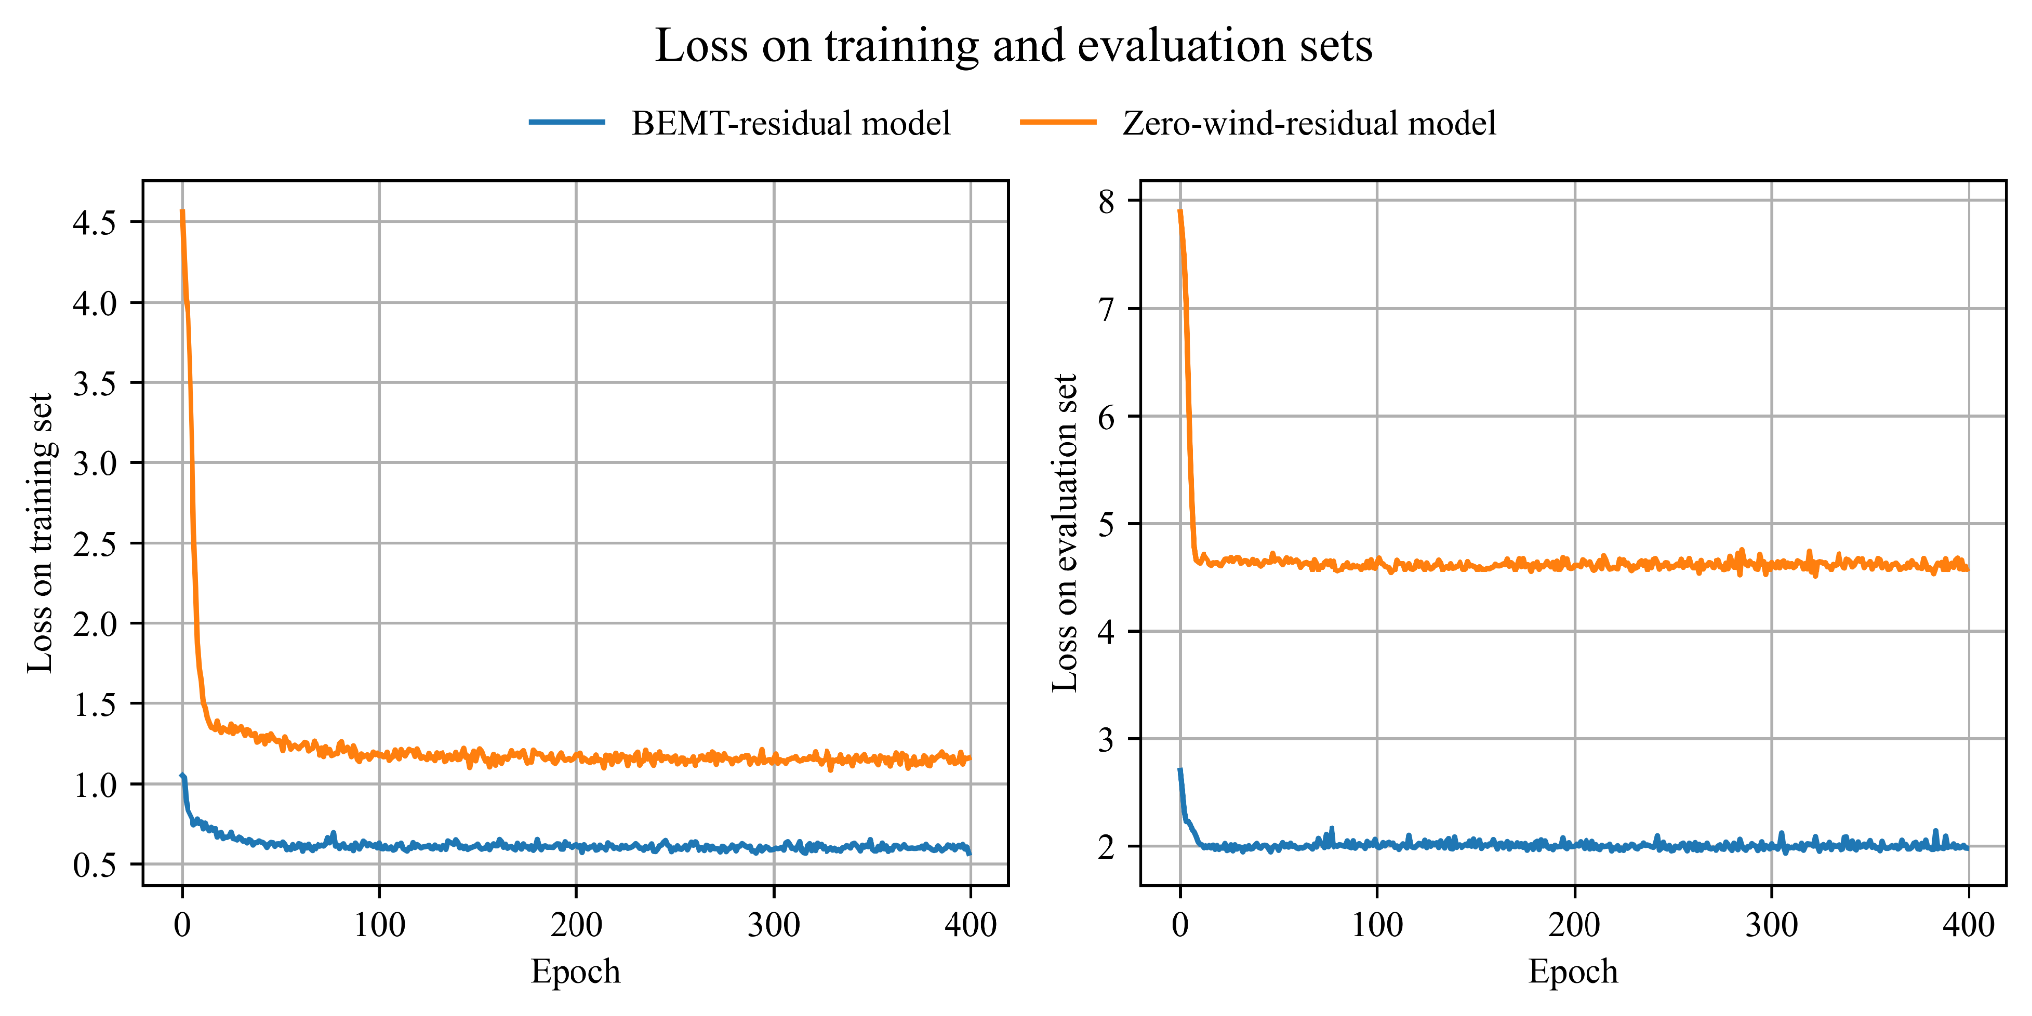
Result – Offline Residual Training
Comparison between learning residual from the proposed physics model and a baseline:
BEMT-residual: learns residuals relative to a physics-based BEMT model
Zero-wind residual: learns residuals relative to a static thrust map
BEMT-residual model:
Better convergence
Better generalizability
Notes:
The resulting training and test losses for both variants are reported in the figure. The comparison shows that the BEMT-residual model achieves consistently lower loss.
This is because the physics-based nominal model explains a larger portion of the aerodynamic effects and allows the residual network to concentrate on finer discrepancies that remain unmodeled.

Slide 15
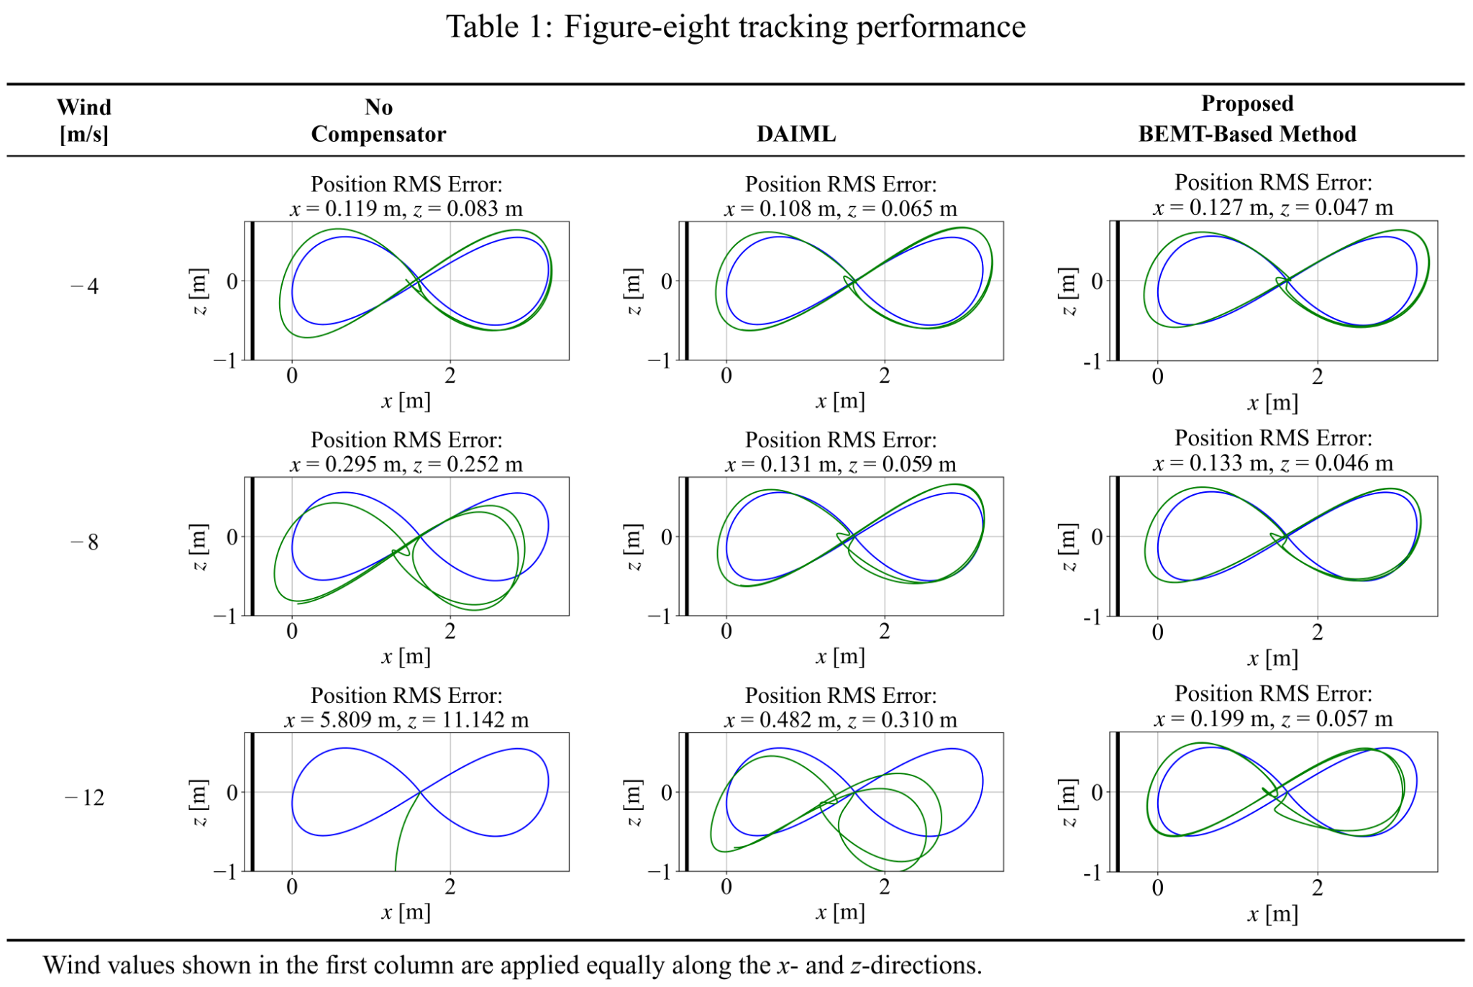
Result – Figure-eight Task
Proposed method:
More robust to disturbance
Smaller tracking error
DAIML is a state-of-the-art disturbance compensation method without physics model infused.
(O’Connell, M., Shi, G., Shi, X., Azizzadenesheli, K., Anandkumar, A., Yue, Y., and Chung, S.-J., “Neural-fly enables rapid learning for agile flight in strong winds,” Science Robotics, Vol. 7, No. 66, 2022, p. eabm6597.)
Notes:
simulate the scenario to approach the wall
The first column wind speed represents the wind speed in both x and z directions.
Here we compare 3 different configurations. …
The solid black line represent the wall location
experiences noticeable bias
no longer stay on reference trajectory, DAIML experiences noticeable bias , proposed method still keeps a good trajectory tracking
DAIML -12 right hand side has more wind far away from wall

Slide 16
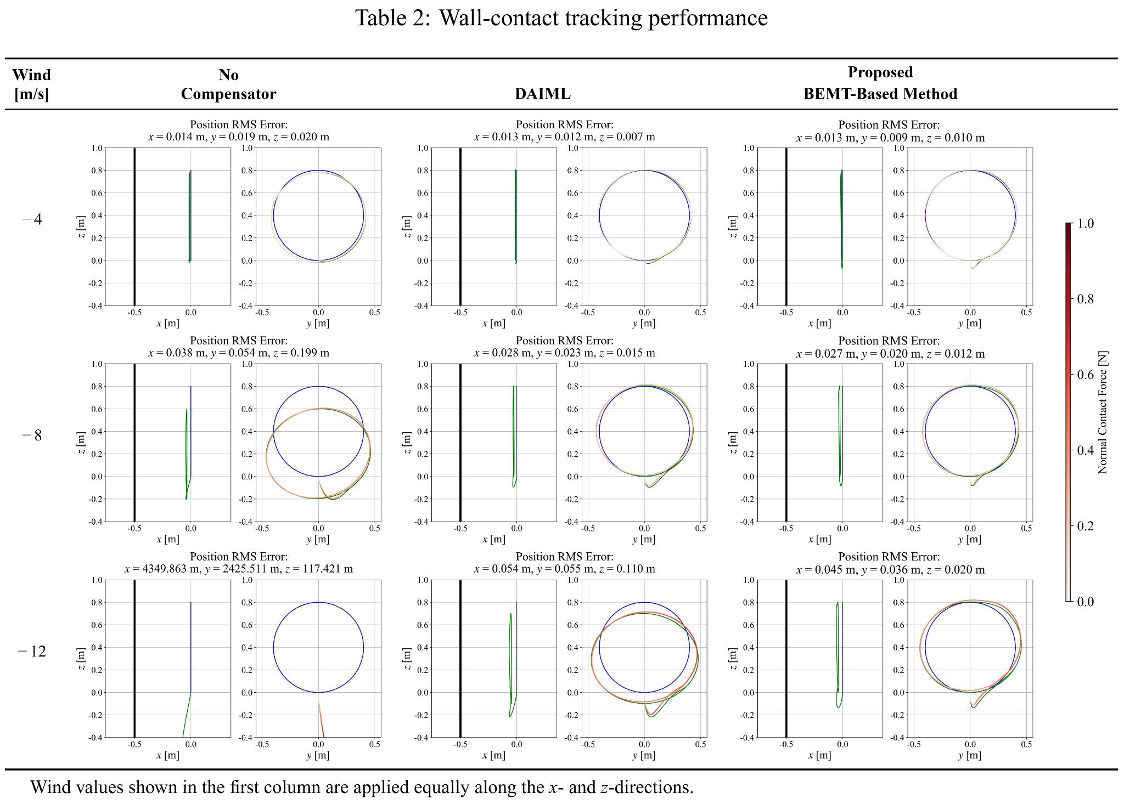
Result – Wall-contact Task
Proposed method:
More robust to disturbance
Better wall-contact consistency
Notes:
(optionally put time series trace)
The color contour represents the magnitude of the contact force along the trajectory.
stay on track, maintain consistent wall contact
noticeable bias in the flight trace, small tracking degradation
no longer stay on reference trajectory, DAIML experiences noticeable bias, proposed method still keeps the most stable force profile, and achieves the highest tracking accuracy

Slide 17
Conclusion
We proposed a physics-infused disturbance-rejection framework.
The framework integrates three components:
a physics based aerodynamic model with parameters learned
a neural-network based residual force model
an online adaptive disturbance observer
By simulation, we showed that the proposed controller achieves improved robustness, smaller tracking errors, and more consistent wall contact
The proposed framework represents a step toward reliable aerial manipulation in realistic environments.
Notes:
add summary / conclusion slide

Slide 18
Thank you!
Notes:
add summary / conclusion slide

